Slide 1

CAPSTONE PROJECT 2
Name : Muhammad Junaid Azam
Course : Data Analytics
Cohort : 21
Database : Northwind
Instructor Name : Ma’am Ilsa
Dated : 16-Novembmer- 2025

Slide 2
Project Overview
End-to-end analysis of the Northwind sales dataset using MySQL for data querying and Power BI for interactive dashboarding.
Objective:
Transform raw transactional data into actionable insights on sales performance, customer behavior, and product profitability.
Outcomes:
A robust, refreshable dashboard enabling stakeholders to monitor revenue, top customers/products, regional trends, and order fulfillment KPIs in real time.

Slide 3
Tables In Northwind Database
Customers
Orders
Employees
Order Details
Suppliers
Shippers
Products
Categories

Slide 4
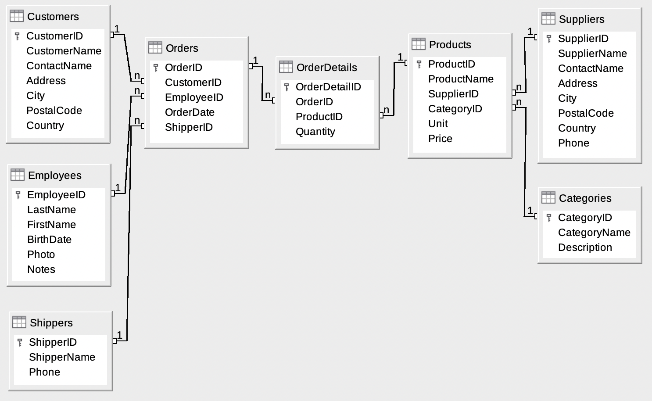
ERD Diagram (Northwind)

Slide 5
Findings Through MySQL
Sales Performance
Customer Segmentation
Category and Product revenue
Employees / Suppliers/ Shippers Summaries
Country wise insights (Geo map)

Slide 6
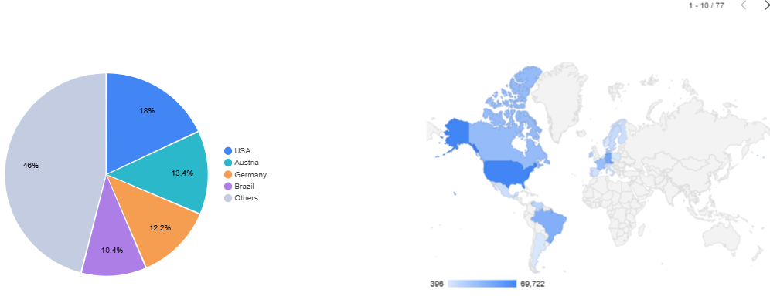
USA and Australia contribute the highest revenue, showing strong customer demand.
Revenue by Country

Slide 7
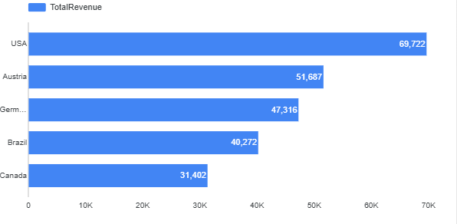
USA leads significantly, with Australia and Canada following closely.
Top 5 Revenue-Generating Countries
These countries should be the top priority regions for targeted marketing and resource allocation.

Slide 8
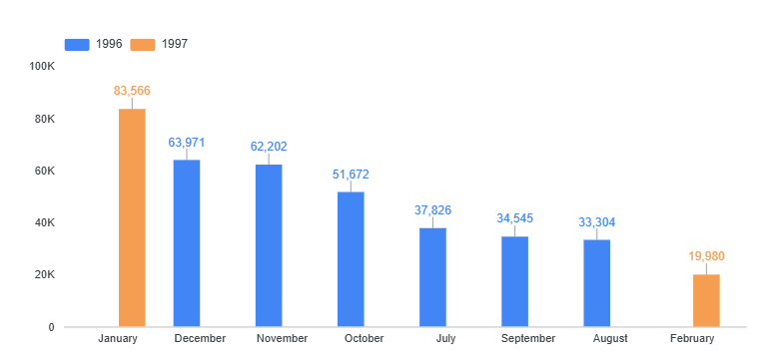
January–February 1997 continue upward before slight decline.
Reveals seasonal buying behavior and sales consistency.
Monthly Revenue Trends

Slide 9
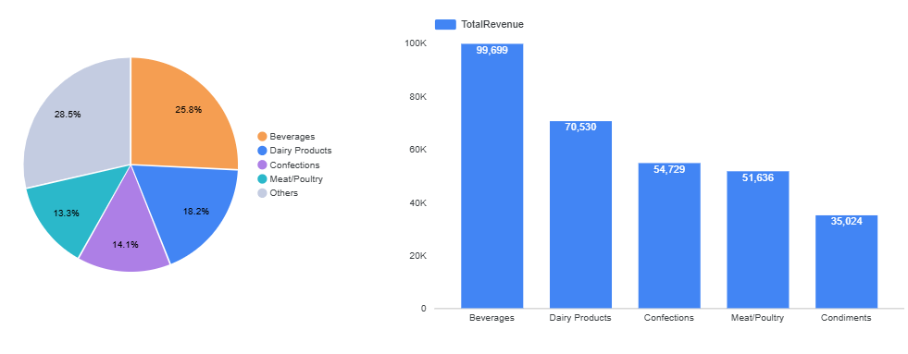
Revenue by Product Category
Beverages and Dairy Products generate the highest sales, emerging as top-performing categories.
Condiments, Meat/ Poultry and Confections show moderate revenue, suggesting reliable performance.
Helps pinpoint categories that deserve priority in inventory and marketing.

Slide 10
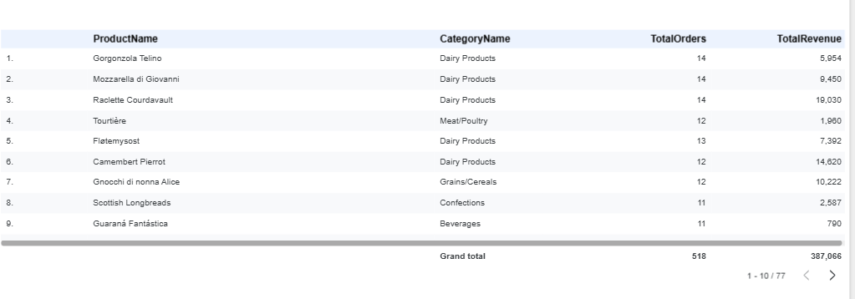
Product and Category-wise Revenue
Products like Côte de Blaye and Chef Anton’s Cajun Seasoning lead their categories.
Low-selling products highlight potential for improvement or replacement.
This analysis supports data-driven product management decisions.

Slide 11
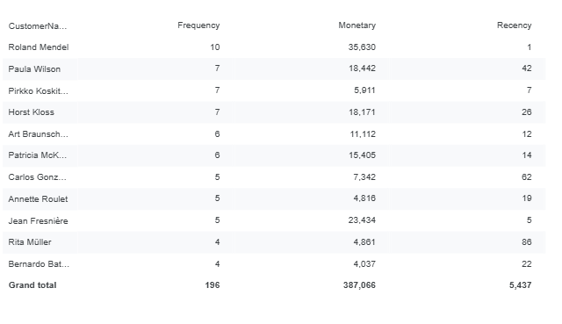
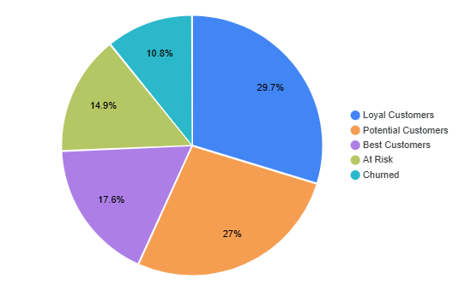
Customer RFM Results
Customer Segmentation Insights
High-RFM customers are highly loyal and contribute strong revenue.
Mid-RFM customers need engagement to boost repeat purchases, while low-RFM customers are close to churn and require reactivation.
Customers like Ronald Mendel and others consistently place orders and drive high revenue.
Their high RFM scores show strong loyalty and repeat buying behavior.
These customers are ideal for premium offers, loyalty programs, and long-term relationship building.

Slide 12
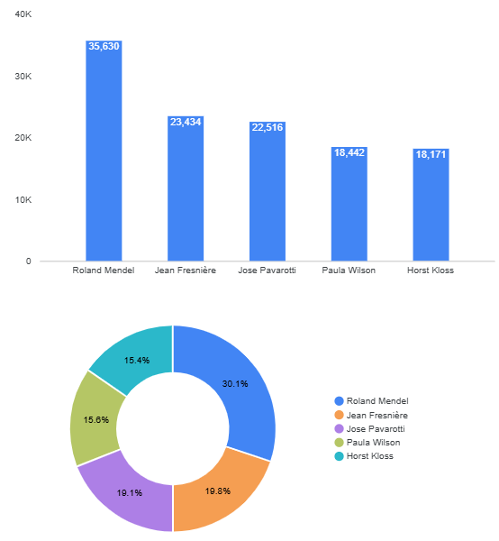
Top 5 Loyal Customers
Top 5 Loyal Customers
Top customers like Ronald Mendel and Jean Freniere dominate revenue contribution.
Their consistent orders reflect strong business relationships.
They’re key for personalized offers and long-term loyalty building.

Slide 13
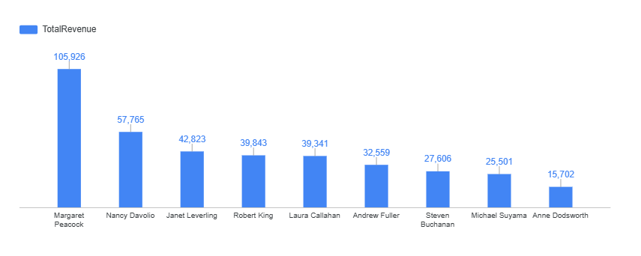
Employees Revenue Performance
Employees like Margaret Peacock, Nancy Davolio and Janet Leverling lead in revenue generation.
They handle high-value clients and maintain efficient sales performance.
Helps management recognize top talent and design incentive programs.

Slide 14
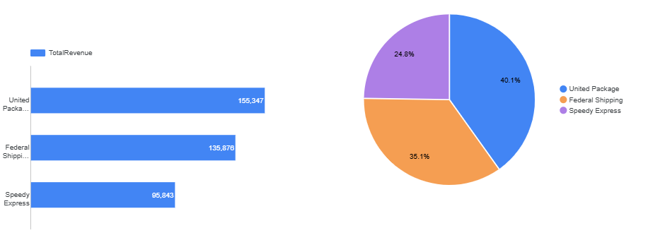
Shipper Performance Overview
United Pakages handles the largest share of shipments and revenue.
Speedy Express and Federal Shipping follow closely behind.
This supports performance evaluation and partnership optimization.

Slide 15
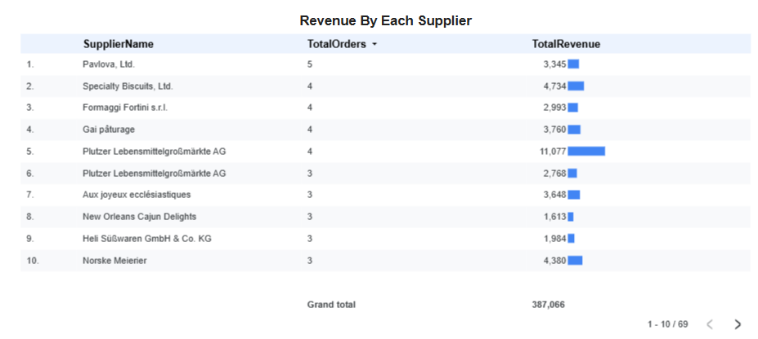
Plutzer Lebensmittelgroßmärkte AG led in total revenue (11,077), followed by Specialty Biscuits Ltd. and Norske Meierier.
This shows which suppliers provide high-value, top-selling products.
Management can use this insight to prioritize strong partnerships for reliable supply and profitability.

Slide 16
Conclusion :
The Northwind dataset analysis reveals key insights into sales performance and operations. The USA and Australia are top markets, with Beverages and Condiments leading in sales. Monthly trends show steady growth, driven by key customers and employees, enabling data-driven decisions for business growth.

